Slide 1
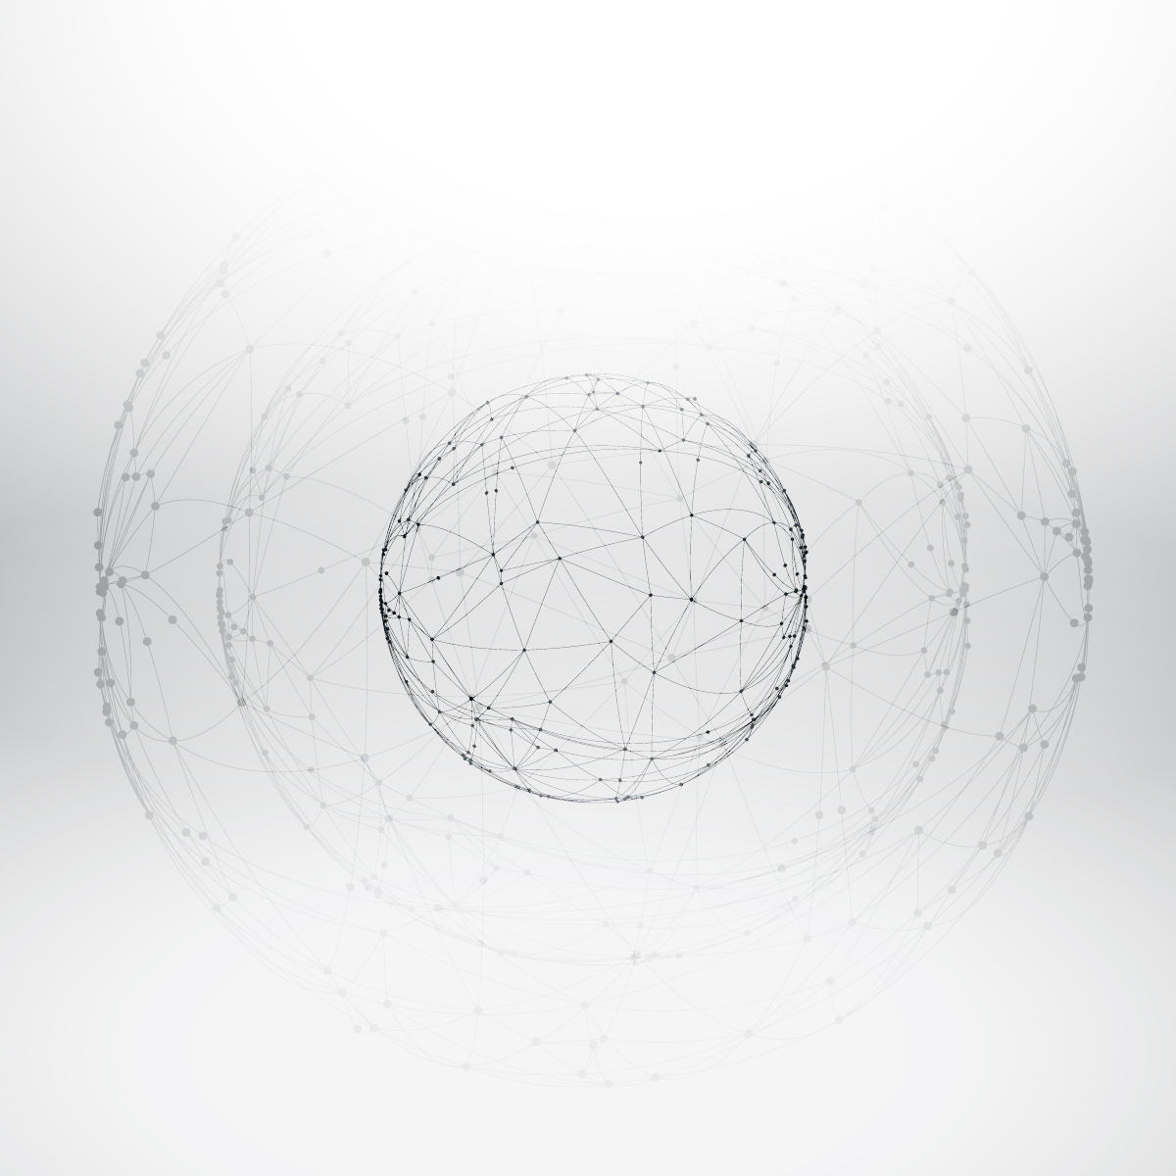



HIERARCHICAL
SHAPE RETRIEVAL
on a
UNIT HYPERSPHERE
Yixin Lin
Glizela Taino
Mark Moyou
Adrian M. Peter

Slide 2
☺
Notes:
Yixin
Can you recognize what this is?
Zela
A smiley face, of course.

Slide 3

Notes:
Yixin
What about this?
Zela
Of course. This is a famous symbol from the novel Watchmen, a smiley face pin defaced by a drop of blood. You can still recognize it despite the color change, rotation, scaling, and of course the blood.

Slide 4
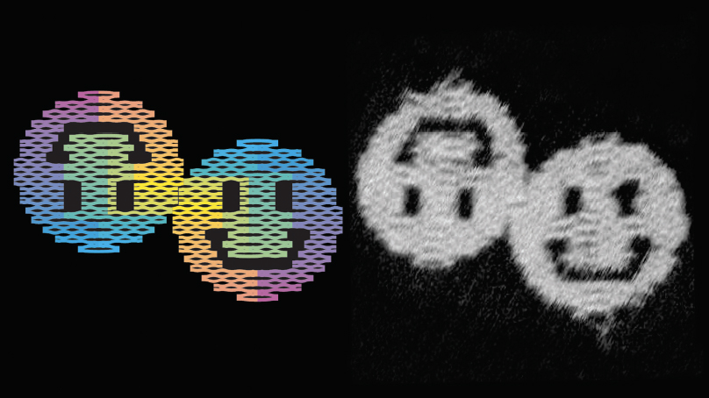
Notes:
Zela
What about this?
Yixin
This is an artificial nanostructure called scaffolded DNA origami. It’s at a scale millions of times smaller than the pin in the last slide. But despite the distortion from the electron microscope… and from being made out of nucleic acid, you can still tell what it is!

Slide 5
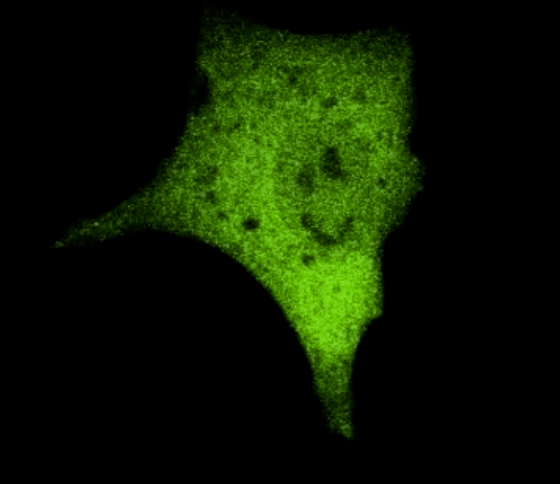
Notes:
Yixin
This is a cancer cell literally laughing at human beings. Again a completely different scale, extreme color change, texture distortion, and warping of the image. Again, we can tell exactly how smug it’s being.

Slide 6

Notes:
Zela
Here’s a smile in the sky.

Slide 7
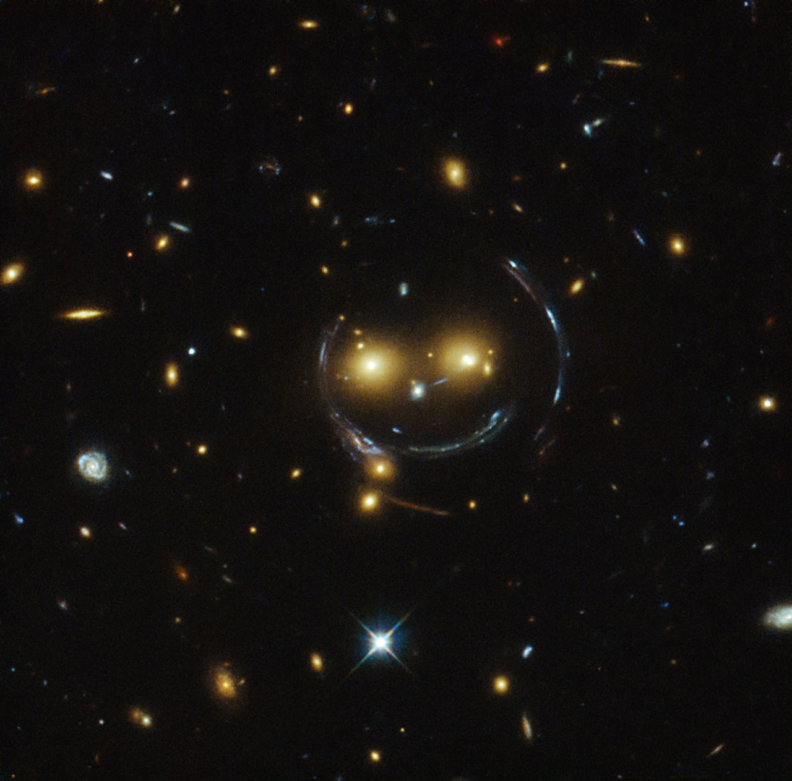
Notes:
Zela
Here’s a smile from outer space, viewed by the Hubble space telescope.

Slide 8

☺
Notes:
Zela
And yet when we see an unhappy face that looks almost exactly identical to a happy one, we can immediately tell it apart.
What is it about these images that let us understand their meaning? It’s certainly not color, nor scale, nor texture. What allows us see through any amount of distortions, imperfections, or warping?
It’s shape. If you don’t understand shape, you’re almost blind.

Slide 9
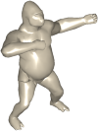
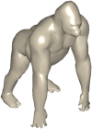




WHAT IS
DATABASE
SHAPE
RETRIEVAL
QUERY SHAPE
Notes:
Yixin
Our goal is to allow computers to understand shape like humans naturally do, to see through all the distortions to capture the essence of an object, an important piece of the quest to make machines more intelligent. The question of shape retrieval is: given a shape, how can we find the most similar shapes from our database? How can we understand these shapes using geometry alone, without any textual metadata or context?

Slide 10

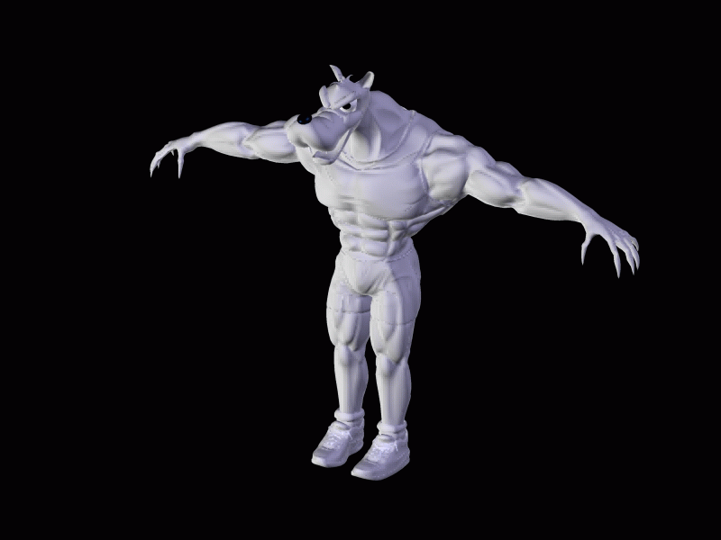
APPLICATIONS
3D
ANIMATION
Notes:
Yixin
One potential application is for use in 3D design and animation. Every billion dollar animated film has millions of 3D shapes that let the story come to life. If you can instantly find the similar ones among those millions of shapes, you can accelerate that creative process tremendously.

Slide 11
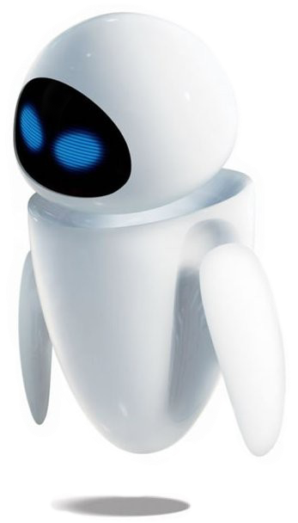

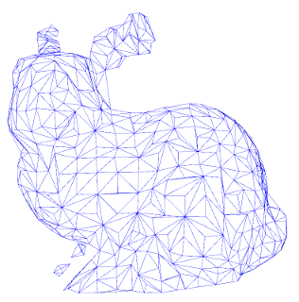
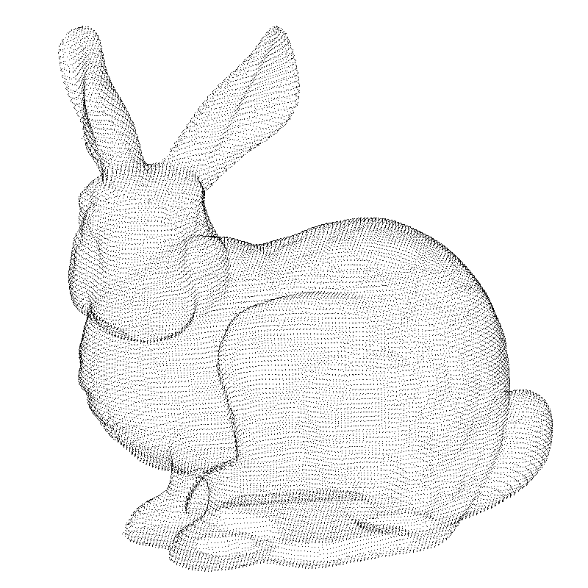
APPLICATIONS
ROBOT
VISION
Notes:
Zela
The potentials for robot and computer vision are even more exciting. Imagine a robot with with a pair of stereoscopic cameras. It can then create point clouds as it explores its environment. If it can use depth and 3D shape in addition to 2D images, it can understand the world it in a more human way.

Slide 12

APPLICATIONS
Shape
Google Search
I’m Feeling Lucky
Notes:
6MIN
Zela
Ultimately, understanding shape is a fundamental problem in computer vision.
Yixin
So if we solve this problem, we get closer to solving other problems we can’t even imagine, like how search engines did for the Internet. The goal is to let another dimension of the world be accessible and retrievable by anyone.

Slide 13
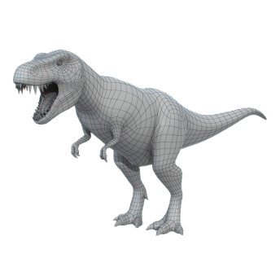

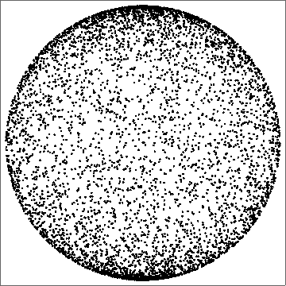
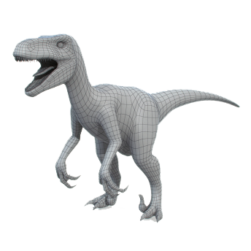
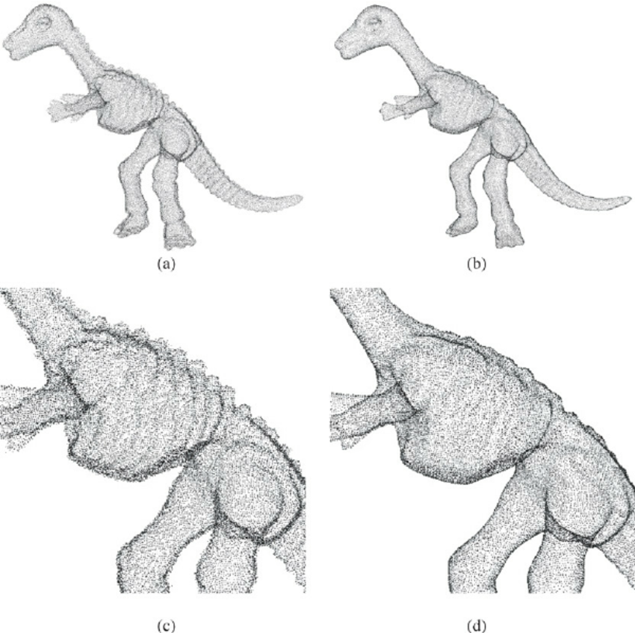
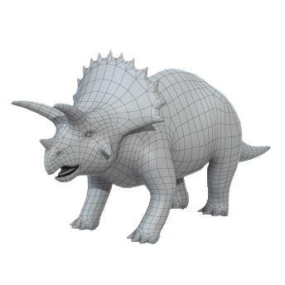
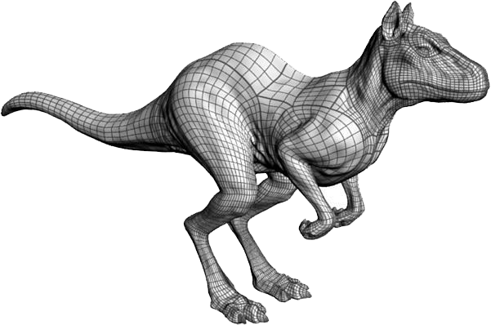
PROBLEM STATEMENT
SHAPE
REPRESENTATION
FEATURE
REPRESENTATION
RETRIEVAL
MECHANICS
1
2
3
Notes:
Yixin
Shape representation
2d points
3d point cloud
3d mesh
We map this onto our feature representation, which is constrained to the surface of a unit hypersphere
Goal is to capture the essence of the data
With this nice feature representation, we can bring all of our machine learning techniques
Our main work is retrieval: given a completely new query shape, what are the ones closest to it?
Let’s first look at the feature representation.
Shape representation given as 2D point sets, 3D point sets, or 3D meshes
Unsupervised data —> have to classify
From SR we transform raw data into a FR that can be utilized in Shape Classification
Not focused on feature representation. Focus on retrieval.
Transition: Important point, SR to FR onto Hypersphere.
** Show 2D Shape, bunny and dinosaur.
** Show animation of dinosaur mapping onto

Slide 14
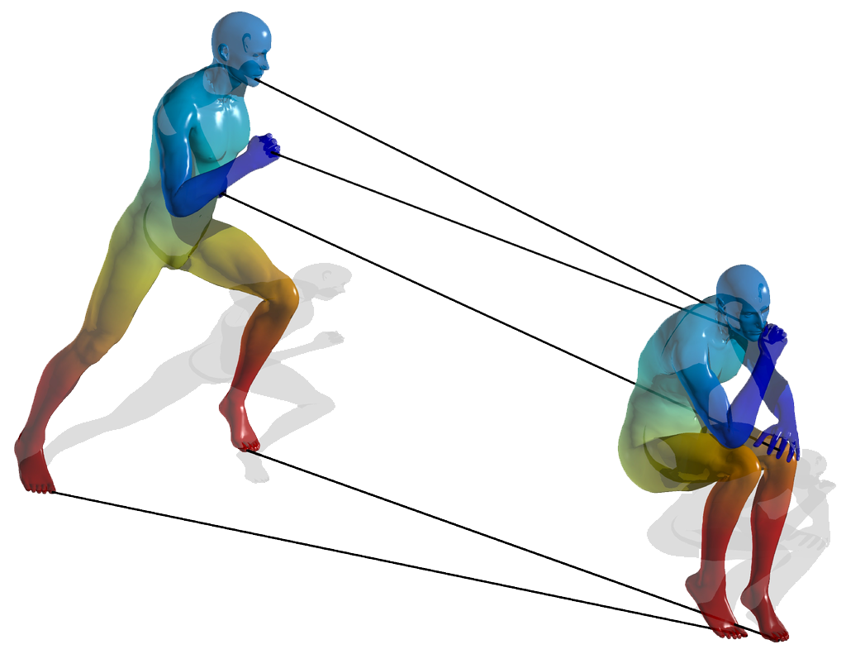

FEATURE REPRESENTATION
ISOMETRY INVARIANCE
Notes:
Yixin
Nice properties of our feature representation:
Brings us to unit hypersphere geometry, simple distance metrics
Isometry invariance: isometries map to the same point
Show better example of isometry invariance. Talk about distances locally on the surface.

Slide 15
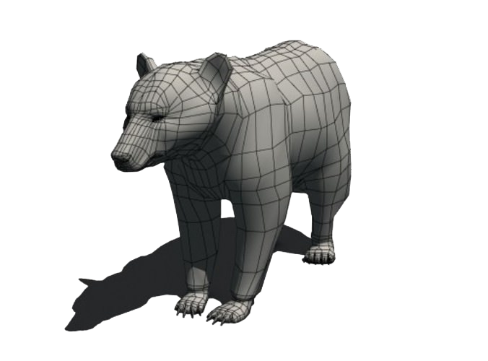
COMPARING
SHAPES ON THE
UNIT HYPERSPHERE
Notes:
Zela
Distances between points signify similarity
Form cluster representations of shape classes, e.g. dinosaurs, bears
Given a new query, we can classify it based on our previous clusters
Emphasize shape classes.

Slide 16

ROADMAP FOR RETRIEVAL
1
KMEANS
2
HYPERSPHERE
CLUSTERING
3
HIERARCHICAL
CLUSTERING
4
DECISION
TREE
5
RETRIEVAL
7
FUTURE RESEARCH
6
METRIC
RESULTS
Notes:
Zela

Slide 17
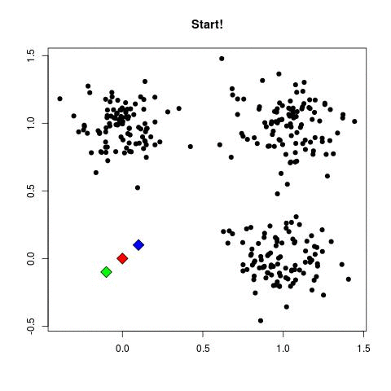
UNDERSTANDING KMEANS
KMEANS CLUSTERING
EUCLIDEAN SPACE
1: generate an initial set of k means
2: while not converged do
3: assign points to nearest centroid
4: calculate new centroids of the
points in the cluster
5: end while
Notes:
Zela
We’re all familiar with the traditional k-means clustering algorithm on a flat space. It picks some initial means, reclusters each datapoint to the closest mean, and recomputes new means, repeating until convergence.
remove.

Slide 18
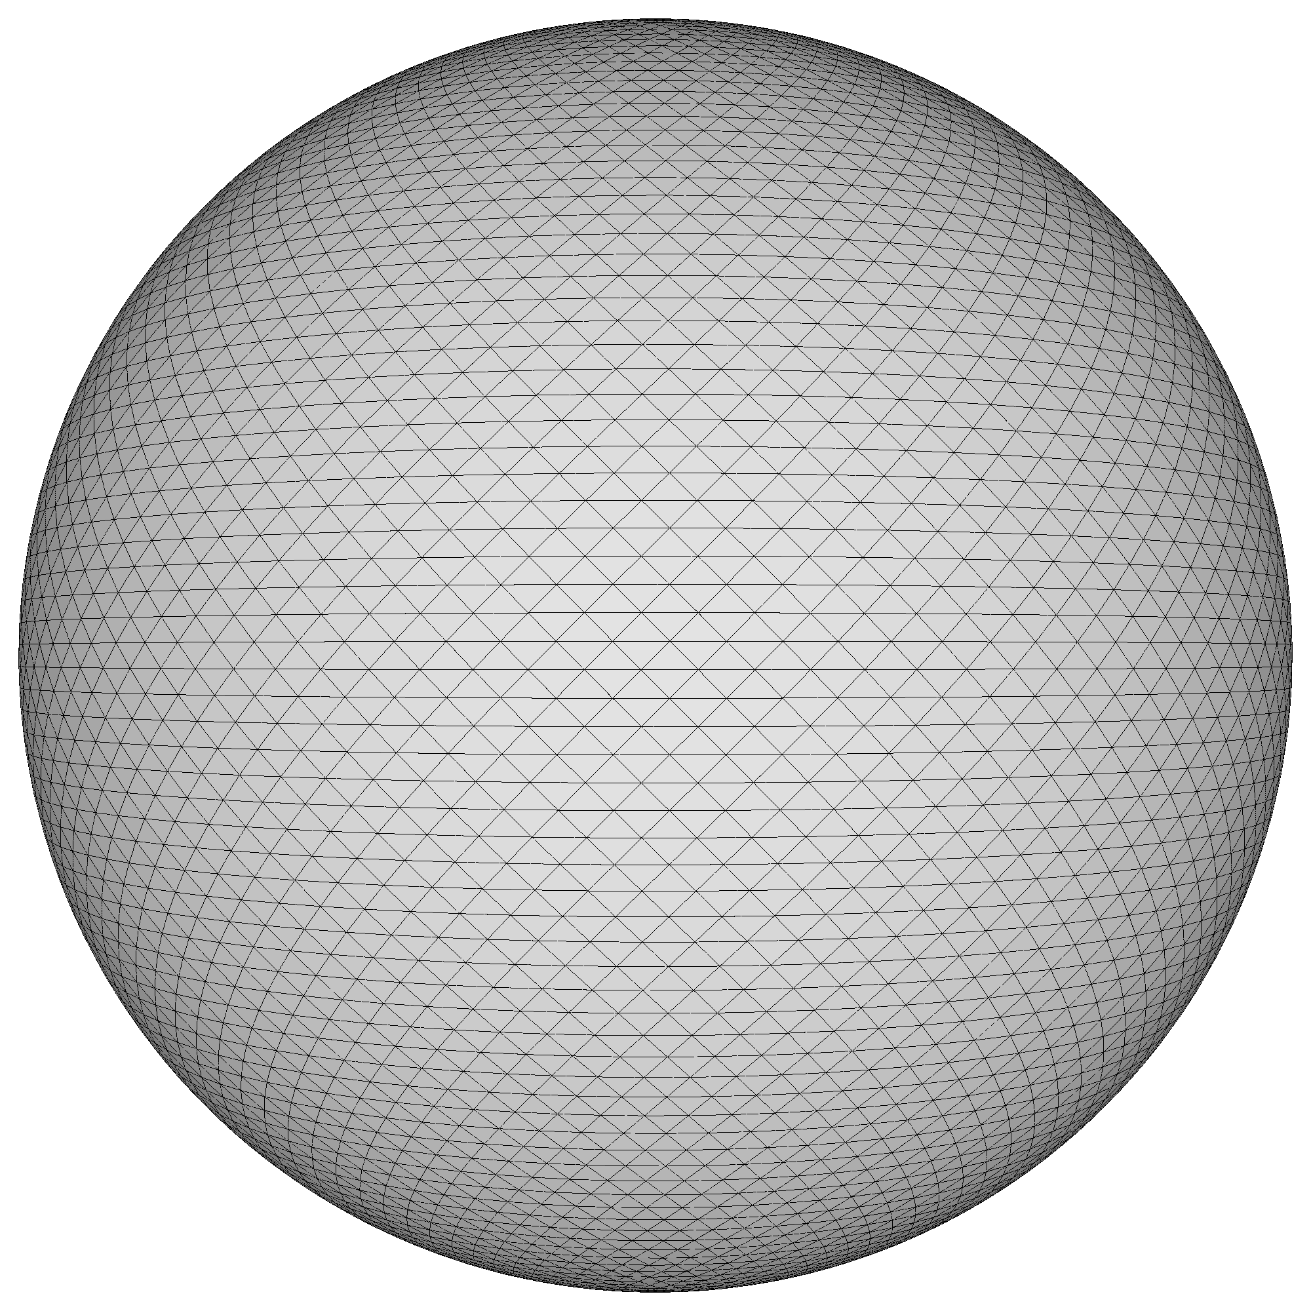
HYPERSPHERE
CLUSTERING
SPHERICAL GEOMETRY
DISTANCES
Notes:
Zela
However, our problem is on a hypersphere, which is a curved surface.
First, we need to figure out how to find distances between two points
Use the angle between them

Slide 19
HYPERSPHERE
CLUSTERING
SPHERICAL GEOMETRY
DISTANCES
Notes:
Zela
However, our problem is on a hypersphere, which is a curved surface.
First, we need to figure out how to find distances between two points
Use the angle between them
Mention you want to compute mean shape and why it’s important.

Slide 20
HYPERSPHERE
CLUSTERING
SPHERICAL GEOMETRY
KARCHER MEAN
Notes:
Yixin
Second, we need to figure out how to find means
Can’t simply take the Euclidean mean: use Karcher mean from differential geometry, which lets you take means on curved surfaces
Show example of exponential and log map.

Slide 21
HYPERSPHERE
CLUSTERING
SPHERICAL GEOMETRY
APPROXIMATION OF
KARCHER MEAN
Notes:
Zela
We used a good approximation that avoids the differential geometry:
This second method finds a centroid using the normalized gravity center. It adds the two vectors and then normalizes it to map back onto the unit hypersphere

Slide 22
HIERARCHICAL
CLUSTERING
Notes:
Yixin 10MIN
Now we know how to cluster on the surface
Shows organization and relationship among clusters
We explored hierarchical clustering as one efficient way to do this
Cluster data points
Then recursively cluster those clusters
There are two algorithms to construct hierarchical clusters
Add graphic that looks like a dendrogram. Epic intro
Yixin
Multilevel hierarchy representing a group of data
Shows organization and relationship among clusters with a dendrogram
Two approaches: Divisive and Agglomerative
Linkage criterion: Determines how to link or split clusters. Using centroid linkage involves taking the average of all points in a cluster and assigning that value as the mean centroid. Then the centroids with the shortest distances are merged together.
Find a better way to summarize this and explain why it’s important.

Slide 23
HIERARCHICAL
CLUSTERING
DIVISIVE
Notes:
Zela
Divisive hierarchical clustering is thought of as a top down approach. This takes in a data set as one large cluster with a single centroid (animation). These nodes are important because they are the average representation of the points beneath it. We’ll keep track of nodes on the tree to the right. This, then branches out and splits the cluster into two more clusters with its own average representation until it reaches the individual observations.
Say “mean shape”. Add “top down”

Slide 24
HIERARCHICAL
CLUSTERING
AGGLOMERATIVE
Notes:
Zela
Agglomerative hierarchical clustering is similar but approach the problem bottom up. It initially looks at each data point as its own cluster. Then it clusters all the data into groups of two, which form the next layer. The means of those clusters are the data points of the next layer. This continues until the entire dataset is represented by a single average centroid. Now we’re going to compare the two methods.
Say “mean shape.” Add “bottom up.”

Slide 25
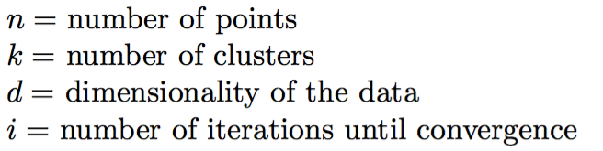
ALGORITHM ANALYSIS
Notes:
Yixin
k - means complexity
agglomerative
divisive

Slide 26
ALGORITHM ANALYSIS
Notes:
Yixin
k - means complexity
agglomerative
divisive

Slide 27
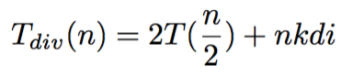
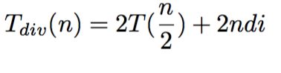
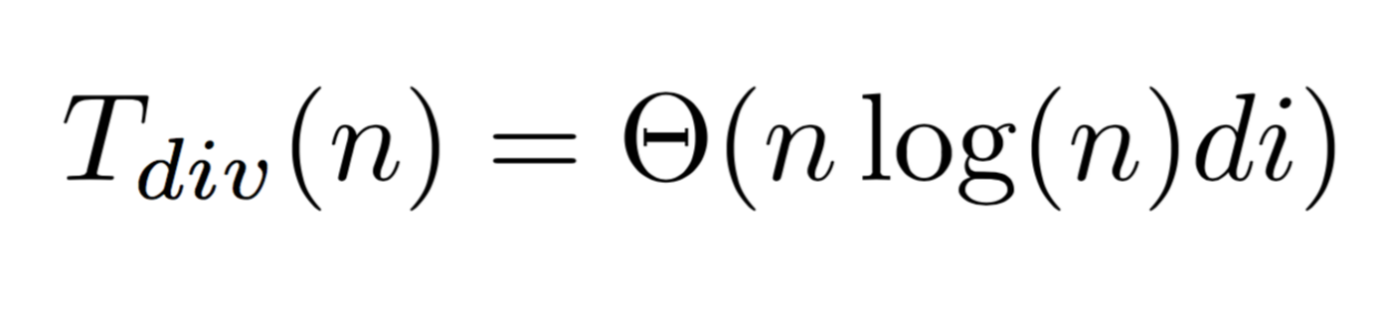
ALGORITHM ANALYSIS
Notes:
Yixin
k - means complexity
agglomerative
divisive
Use bigger parenthesis.

Slide 28
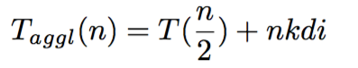
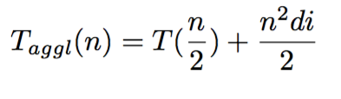
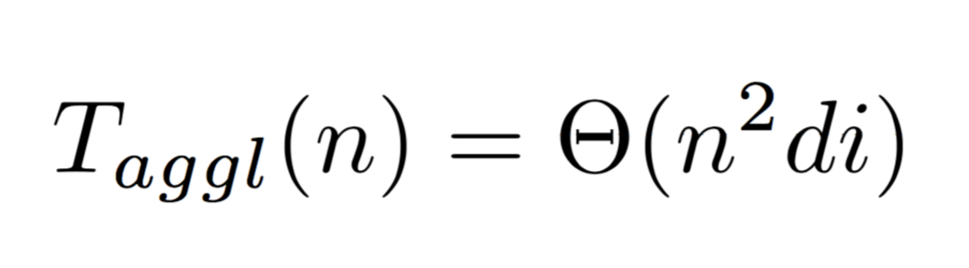
ALGORITHM ANALYSIS
Notes:
Yixin
k - means complexity
agglomerative
divisive

Slide 29
ALGORITHM ANALYSIS
Notes:
Yixin
k - means complexity
agglomerative
divisive

Slide 30
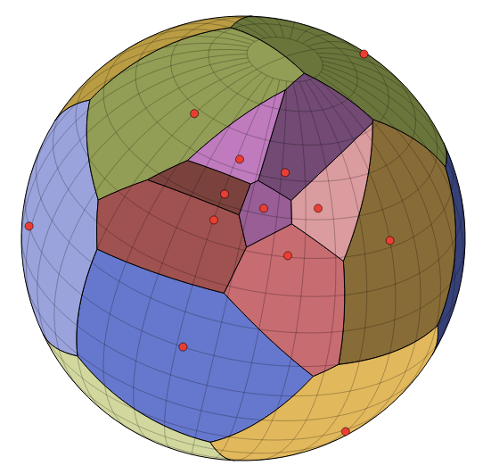
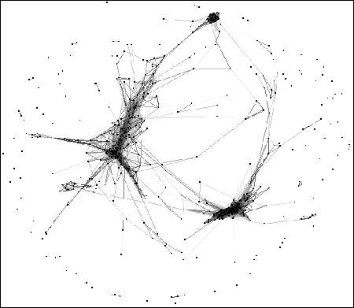
HIERARCHICAL
CLUSTERING
Notes:
14MIN Yixin
We wrote both hierarchical clustering algorithms
We tested them, as well as a built-in MATLAB one, on standard datasets
Thousands of data points which live on 13,000 dimensional
Illustration of tree structure with means
Example Voronoi diagram: which points are clustered with which means
Mention unsupervised hierarchical clustering.

Slide 31
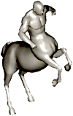
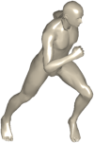
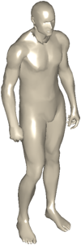
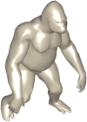
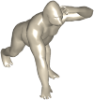

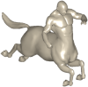
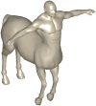
DECISION TREE & RETRIEVAL
FOUR LEGS
TWO LEGS
DOG
CENTAUR
HUMAN
GORILLA
Notes:
Zela
So how does all of this help us in our overall goal? Let’s do a quick over view of whats happening. We we’re given a data base. We clustered each shape in the data base. When you give us a query, we run it through the decision tree to give you back the most similar object as efficiently as possible. (Animation) a query shape comes in and begins to traverse the tree. Is the object closer to this point or this point? It will traverse again and ask is the object closer to this point or this point? And once it hits the leaves it will compare to the objects in the subtree and retrieve the closest one. And because this is a balanced tree, it takes log(n) time.
The goal is to figure out what the closest points are, efficiently
For each internal node in the tree, find the closest subtree mean (using spherical distance, aka Karcher mean)
Once you get to a leaf, you have the “closest” object, but in log(n) time
log(amount of data points) 2^n = h
h = log2(n)
Mention “standard data set.” Show an ordered list.

Slide 32
DECISION TREE & RETRIEVAL
FOUR LEGS
TWO LEGS
DOG
CENTAUR
HUMAN
GORILLA
Notes:
Yixin
Retrieval implementation
How do we grab multiple results? Retrieval, not classification
Use a recursive mergesort-like algorithm (except not really)
At each level, return the concatenation of the closer and the farther subproblems

Slide 33
METRICS AND RESULTS
number of retrieved & relevant
=
1/1
_______________________________
PRECISION
1/2
2/3
2/4
number of retrieved
number of retrieved & relevant
=
1/2
_______________________________
RECALL
1/2
2/2
2/2
number of relevant
Notes:
Zela
Suppose we got this result from retrieving with this centaur query
We would then evaluate retrieval mechanisms on standardized metrics
Precision recall
Keep PR definitions on the slide and add two more shapes.

Slide 34
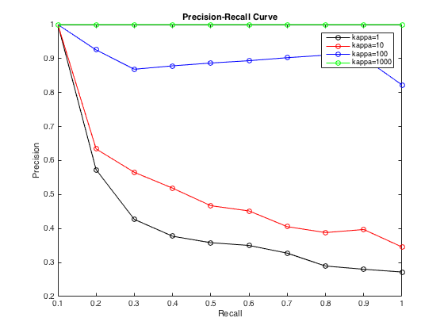
METRICS AND RESULTS
Notes:
Yixin
Precision recall curve
First we randomly constructed spherical clusters using the von Mises distribution (generalization of the normal distribution on a circle)
Depending on the kappa value (concentration parameter), it performed quite well
Higher kappa means more concentrated, better retrieval (less overlap)
When clusters don’t overlap, it gets nearly perfect scores
Bigger legend. Show von mises. Emphasize perfect retrieval.

Slide 35
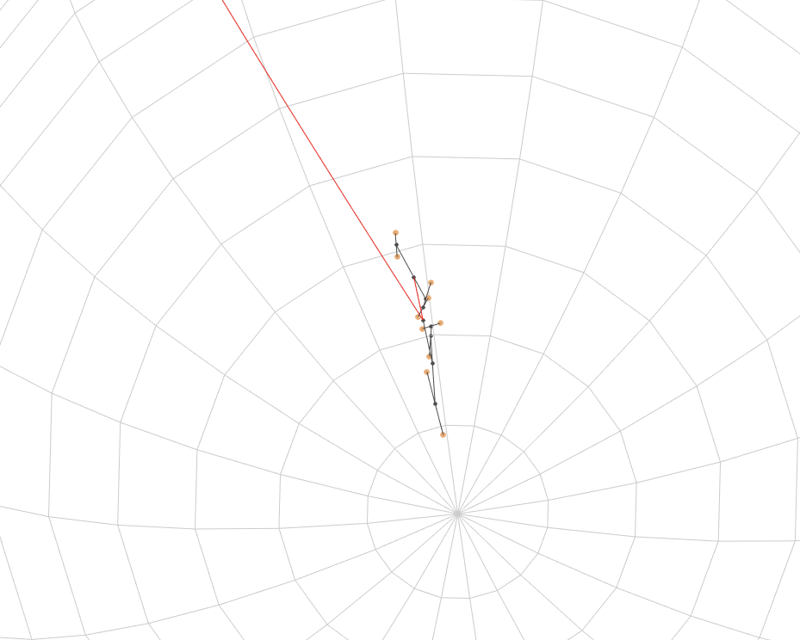
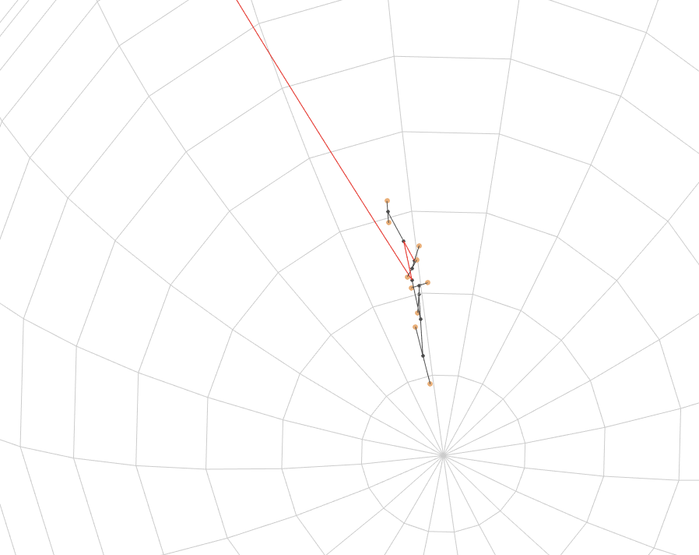
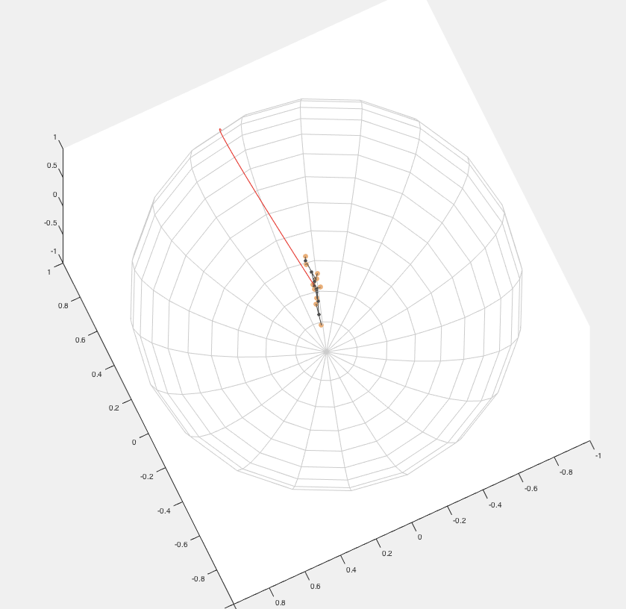
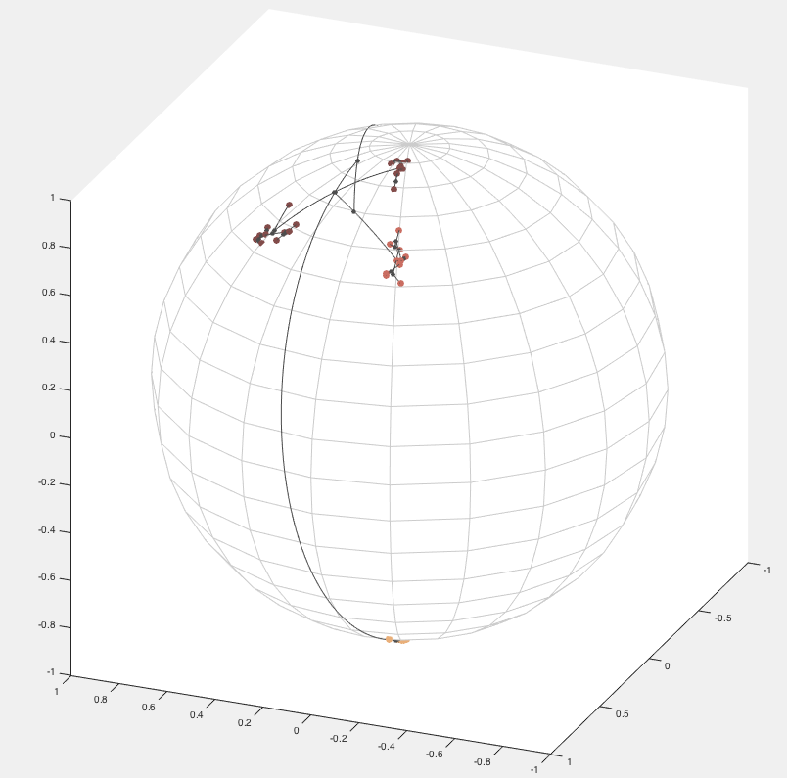
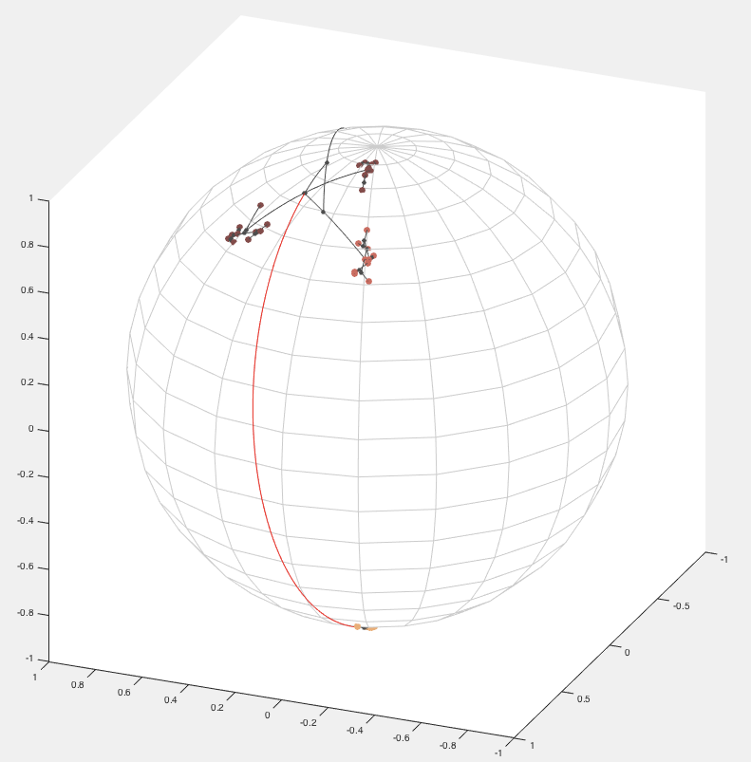
METRICS AND RESULTS
Notes:
Yixin
Then we ran it on common datasets
Very good at nearest neighbors (close to 1)
Not so good on some of the other metrics (outperformed by state of the art)
Clusters overlap in higher dimensions, explore different ways of fitting the structure of the data
Yixin
Clustering Graphics
Explain how well our approach worked

Slide 36
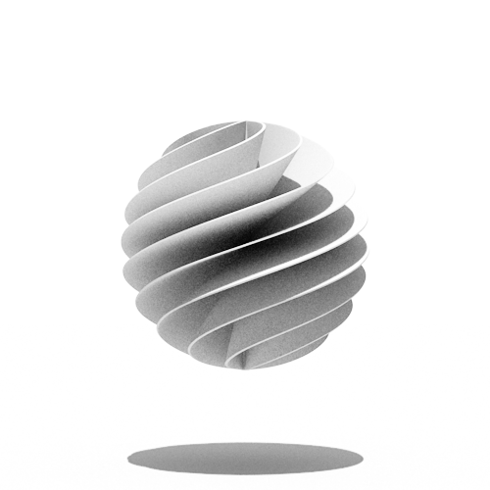
CONCLUSION
Notes:
Zixin
We’ve explored the significant problem of shape analysis and retrieval, important for many applications including 3d animation and design and robot and computer vision
We’ve implemented a faster retrieval data structure and retrieval mechanism that runs in O(log(n)) instead of O(n)
We proved the running time of hierarchical clustering using spherical K-means
Create a visual conclusion.

Slide 37
FUTURE RESEARCH
RETRIEVAL
MECHANICS
Run on standard retrieval datasets
Investigate alternative retrieval structures
FEATURE
REPRESENTATION
Delve deeper into the wavelet density estimation
Optimize wavelet density estimation code
Linear Assignment
Notes:
Zixin
Next Phase
Improve shape retrievals
Run on datasets
Investigate alternative retrieval structures
Begin optimizing calculating feature representations
Delve deeper into the wavelet density estimation
Optimize wavelet density estimation code
Linear assignment of wavelet coefficients: how can we “distort” or manipulate the feature representation so that close shapes are closer together?

Slide 38

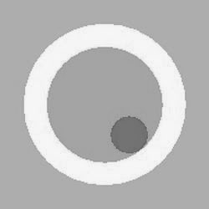
THANK YOU

